Slide 1

Book recommendation
Notes:
NOTE:
To change the image on this slide, select the picture and delete it. Then click the Pictures icon in the placeholder to insert your own image.

Slide 2

Agenda
Introduction
Primary Goals
EDA
Model Building
Deployment

Slide 3
Introduction
Recommendation systems are widely used today to recommend products to users based on their interests. A recommendation system is one of the strongest systems for increasing profits by retaining more users in a very big competition. In this article, I’ll walk you through how to build a book recommendation system with Machine Learning using the Python programming language.
The purpose of a book recommendation system is to predict buyer’s interest and recommend books to them accordingly. A book recommendation system can take into account many parameters like book content and book quality by filtering user reviews. In the section below, I will introduce you to a machine learning project on the book recommendation system using Python
Book reading and selling websites like Kindle and Goodreads compete against each other on many factors. One of those important factors is their book recommendation system. A book recommendation system is designed to recommend books of interest to the buyer.

Slide 4
Business Objective
Generate the features from the dataset and use them to recommend the books accordingly to the users.
We Have three Data set:
Book
Rating
User
Data Set Content:
Books:- Books are identified by thire respective ISBN ,some content-based information is given Book Title,Book Author, Year Of Publication, Publisher and Url linking to cover pages are also given in three different Flavours(large,Medium,Small)
Rating:- Rating Contains the Book rating Information given by Users with Unique ISBN no. of Books
User:- Contains the user Id have been annoymized and map to integers. Demographic data is provide(location) and age of users

Slide 5
exploratory Data analysis (EDA)

Slide 6
Basic EDA
Info
Describe
Null Values/ Fillnall
Duplicates
Count Values
Group by
Drop ( Columns, Index, Row )
Rename
Spilt
Unique Valuse

Slide 7
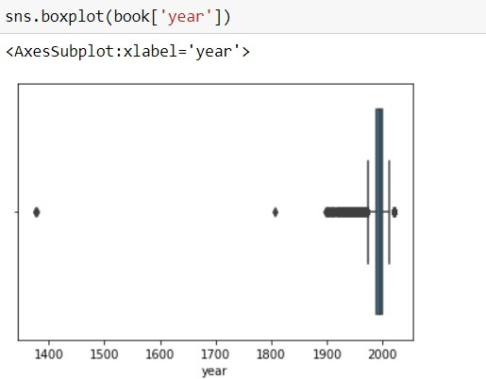
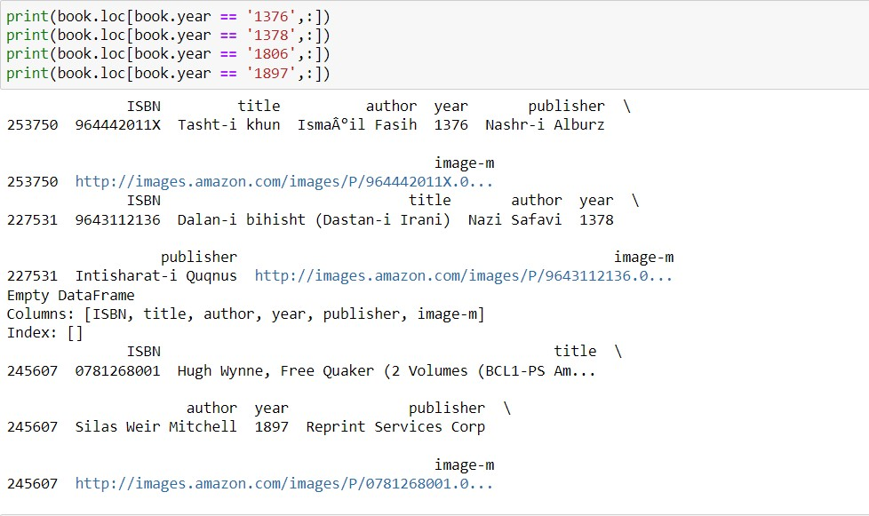
Data Cleaning/Preprocessing
Checking Outlier plotting on Box Plot
Checking Actual Row by using Pythone code
After conforming Outlier we will drop that Row From Book Data set.

Slide 8
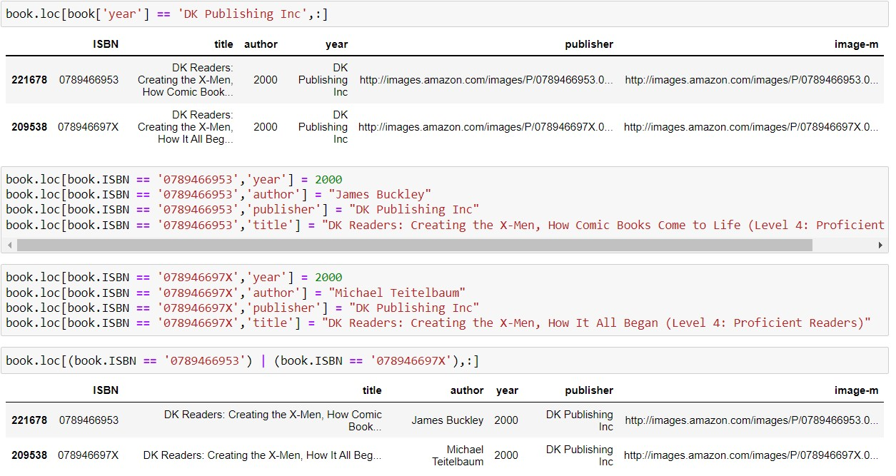
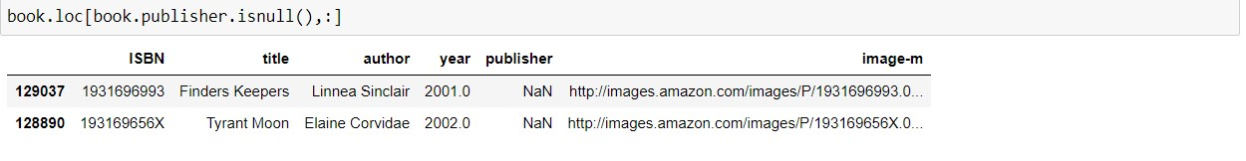
Book Data set
Data Mismatch on Year and Publisher
Checking Author Column is there null value or not
We Interchanger the That row Column which is fill with correct information.
In author column we check same Publisher ,same related book then we did not find similarity then we drop that row or we can put it/ mention in other publisher

Slide 9
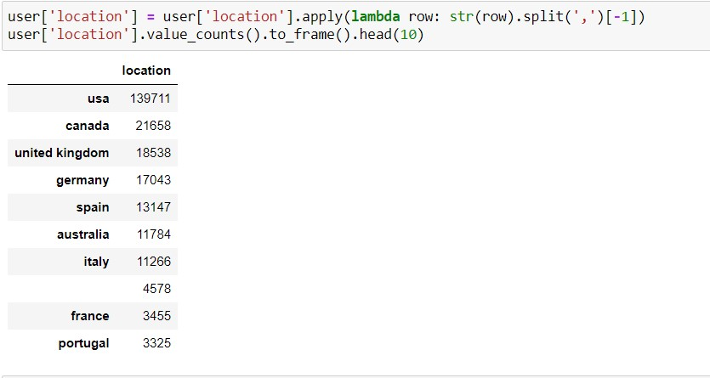
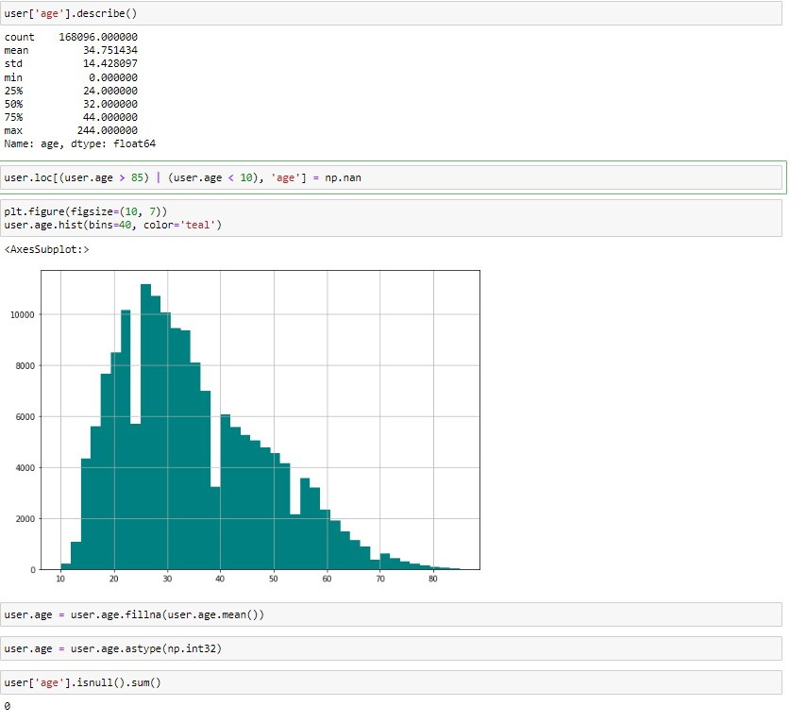
User data Set
Counting Values as per Country
Age Distribution Plot Using Histogram
In the location column we use lamdazetion and string and split the country using coma
In age column we put it condition in age grater 85 and less 10 and remove that outlier then that value fill as null after that null values fill with mean of age as user age

Slide 10
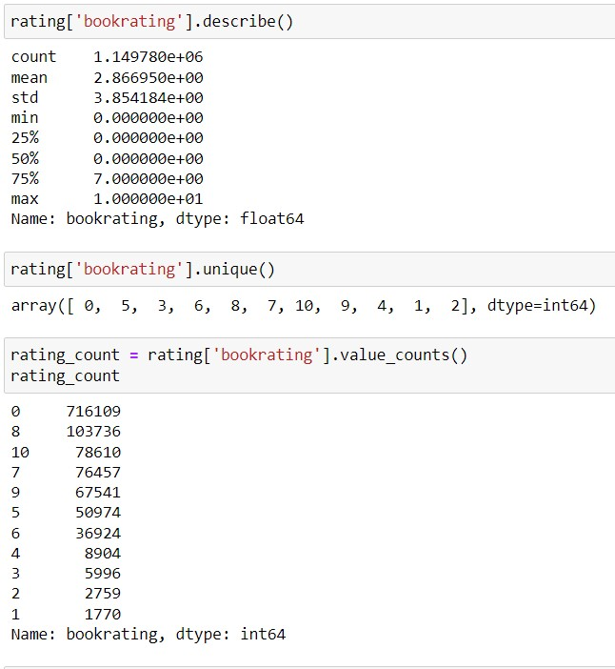
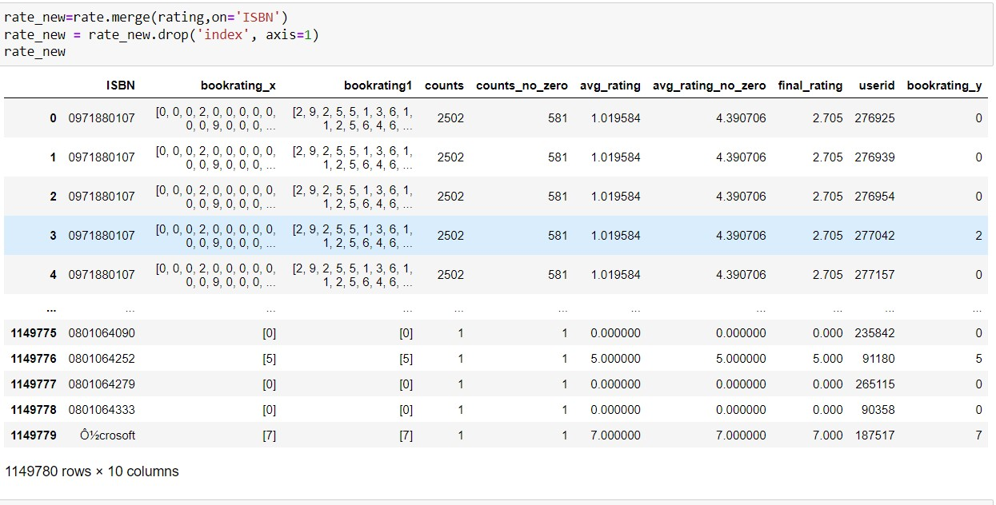
Rating Data Set
Rating Count and Description
Calculate average values of given rating by user (with zero and without zero)

Slide 11
Model - Building

Slide 12
Basics of Recommendation Modeling Approaches Broadly speaking, most recommender systems leverage two types of data:
Interaction Data, such as ratings, and browsing behaviors, and
Attribution Information, about each users and items
The modeling approach relying on the former data are generally known Collaborative Filtering method,
and approach using the later are referred to as Content Base Filtering method.
There is also another category known as Knowledge-Based recommender system that is based on explicitly specified user requirements.
Of course, each of these methods has its strengths and weaknesses depending on which applications they are used for, and the amount of data available.
Hybrid Systems are then used to combined the advantages of these approaches to have a robust performing system across a wide variety of applications.
Type of Filtering:
Popular Base Filtering
Collaborative Filtering
Content Base Filtering
Hybrid Base Filtering
We Use Two Model Building Filtering
Popular base Filtering
Collaborative filtering

Slide 13
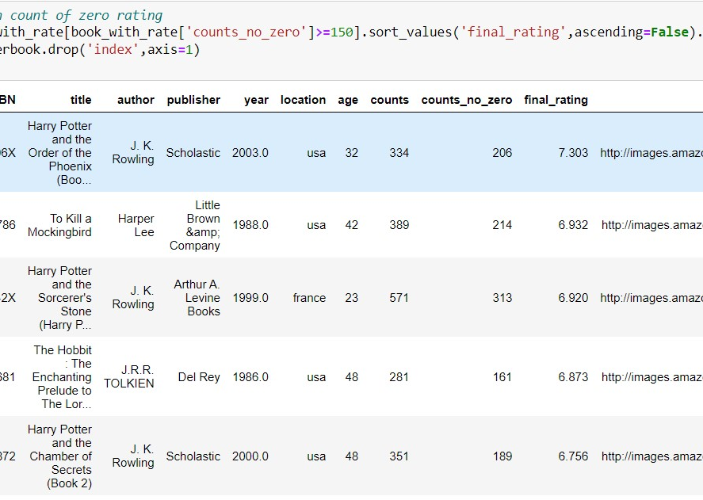
Popular Base Filtering
These types of models use the Popular base Filtering power of the ratings provided by multiple users to make recommendations.
In the filtering we set condition which is the book has minimum rated by user that is 150 and arrange by the descending order by Final rating
We can also short the Popular books as per Country like USA, Canada , UK
We also short the Popular books as per User age like Teenager, younger, Mid age Adult and Seniors another hand we can also shot popular books as year of Publication

Slide 14
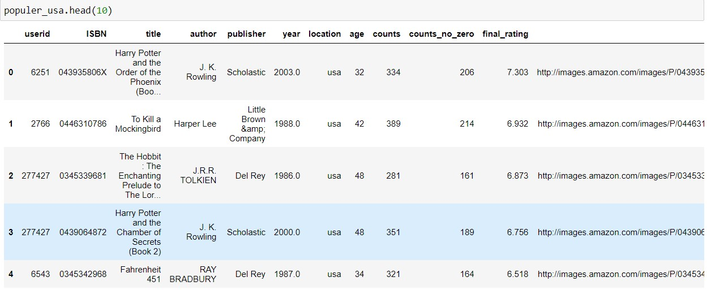
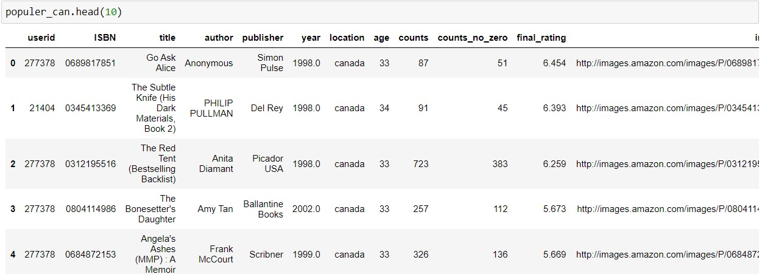
Shorting Popular Books by County
USA
Canada

Slide 15
Collaborative Base Filtering
There are two types of methods that are commonly used in collaborative filtering:
Memory-based methods also referred to as neighborhood-based collaborative filtering algorithms, where ratings of user-item combinations are predicted based on their neighborhoods. These neighborhoods can be further defined as :
User Based
Item Based
In Model-based methods, ML techniques are used to learn model parameters within the context of a given optimization framework
These types of models use the collaborative power of the ratings provided by multiple users to make recommendations and rely mostly on leveraging either inter-item correlations or inter-user interactions for the prediction process.
Intuitively, it relies on an underlying notion that two users who rate items similarly are likely to have comparable preferences for other items.

Slide 16
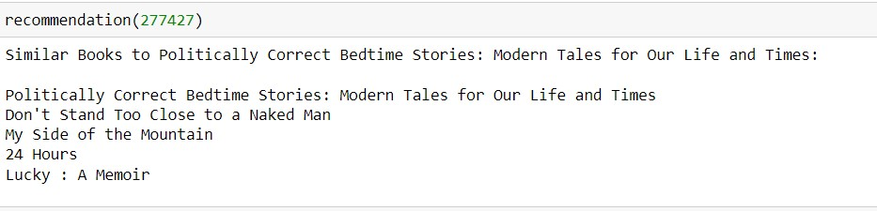
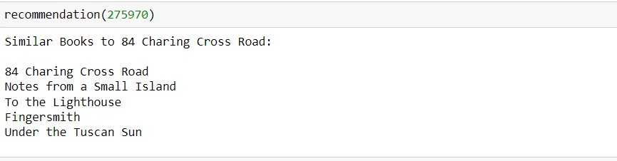
Examples
User: 277427
User: 275970

Slide 17

DEPLOYMENT
It is web application which is show the recommendation for Various users according to Available Data set
In this app background run all the ML algorithms and Model which was we trained

Slide 18
Contacts

Slide 19
Group Members
Sr. No. | Name | Contact No. | G-mail | GitHub ID
1 | Mr. Prashant Khandekar | 703087**49 | pkhandekar108@gmail.com | Prashantkhandekar
2 | Miss. Prajakta Sodde | 866896**72 | prajktasodde27@gmail.com | prajktasodde
3 | Mr. Ayush Patidar | 913198**46 | ayushpatidar1712@gmail.com | Ayushpaatii1712
4 | Mr. Prasad Waje | 899971**55 | prasadwaje2029@gmail.com | Prasadwaje
5 | Mr. SYED MUJTABA HASSAN NABEEL | 8142548013 | sdmujtaba26@gmail.com | Syed-Nabil26
6

